Slide 1
Online Clothes Shop
E4 Web Application
Notes:
1

Slide 2
Agenda
Introduction
Primary goalsTimeline
Summary
PRESENTATION TITLE
2
Notes:
2

Slide 3
Introduction
At Contoso, we empower organizations to foster collaborative thinking to further drive workplace innovation. By closing the loop and leveraging agile frameworks, we help business grow organically and foster a consumer first mindset.
PRESENTATION TITLE
3
Notes:
3

Slide 4
Primary goals
Annual revenue growth
Notes:
4

Slide 5
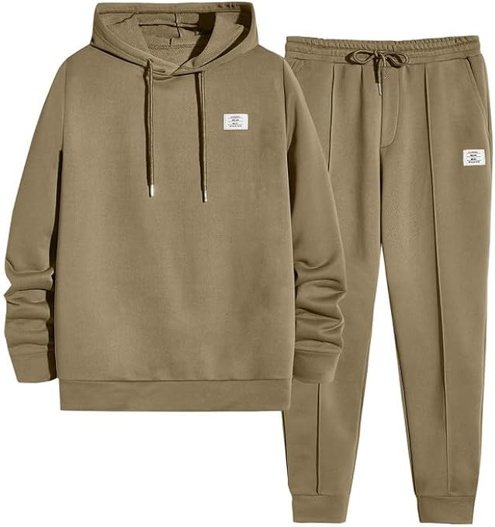
Product
JMIERR Men's 2 Piece Outfits Hoodie Sweatshirt Tracksuit & Joggers Sweatpants Sweatsuit Set
Color
Size
S
M
XL
XXL
-
1
+
Add to Cart
Notes:
5

Slide 6
Business opportunities are like buses. There's always another one coming.
“
”
Richard Branson
PRESENTATION TITLE
6
Notes:
6

Slide 7




Meet our team
Takuma Hayashi
Mirjam Nilsson
President
Chief Executive Officer
Flora Berggren
Rajesh Santoshi
Chief Operation Officer
VP Marketing
PRESENTATION TITLE
7
Notes:
7

Slide 8








The full team
Takuma Hayashi
Mirjam Nilsson
Flora Berggren
Rajesh Santoshi
President
Chief Executive Officer
Chief Operations Manager
VP Marketing
Graham Barnes
Rowan Murphy
Elizabeth Moore
Robin Kline
VP Product
SEO Strategist
Product Designer
Content Developer
PRESENTATION TITLE
8
Notes:
8

Slide 9
Plan for product launch
Planning
Synergize scalable e-commerce
Marketing
Disseminate standardized metrics
Design
Coordinate
e-business applications
Strategy
Foster holistically superior methodologies
Launch
Deploy strategic networks with compelling e-business needs
1
2
3
4
5
PRESENTATION TITLE
9
Notes:
9

Slide 10
Timeline
Sep 20XX
Jan 20XX
May 20XX
Synergize scalable e-commerce
Coordinate e-business applications
Deploy strategic networks with compelling e-business needs
Disseminate standardized metrics
Foster holistically superior methodologies
Nov 20XX
March 20XX
PRESENTATION TITLE
10

Slide 11
Areas of focus
B2B market scenarios
Cloud-based opportunities
Develop winning strategies to keep ahead of the competition
Capitalize on low-hanging fruit to identify a ballpark value
Visualize customer directed convergence
Iterative approaches to corporate strategy
Establish a management framework from the inside
PRESENTATION TITLE
11

Slide 12
How we get there
ROI
Niche Markets
Supply chains
Envision multimedia-based expertise and cross-media growth strategies
Visualize quality intellectual capital
Engage worldwide methodologies with web-enabled technologies
Pursue scalable customer service through sustainable strategies
Engage top-line web services with cutting-edge deliverables
Cultivate one-to-one customer service with robust ideas
Maximize timely deliverables for real-time schemas
PRESENTATION TITLE
12

Slide 13
Summary
At Contoso, we believe in giving 110%. By using our next-generation data architecture, we help organizations virtually manage agile workflows. We thrive because of our market knowledge and great team behind our product. As our CEO says, "Efficiencies will come from proactively transforming how we do business."
PRESENTATION TITLE
13

Slide 14
Thank you
Mirjam Nilsson​
mirjam@contoso.com
www.contoso.com

